Slide 1
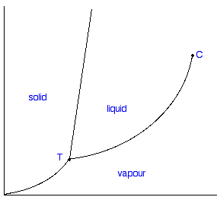
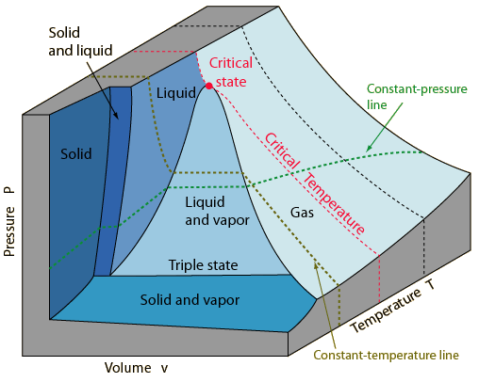

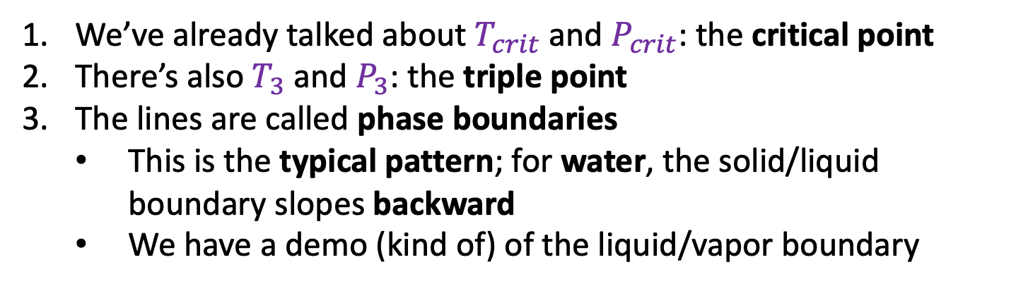



Phase diagrams
$$P_{3}$$
$$T_{3}$$
$$T_{crit}$$
This is a typical phase diagram
We’ve already talked about $T_{crit}$ and $P_{crit}$: the critical point
There’s also $T_{3}$ and $P_{3}$: the triple point
The lines are called phase boundaries
This is the typical pattern; for water, the solid/liquid boundary slopes backward
We have a demo (kind of) of the liquid/vapor boundary

Slide 2

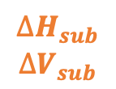
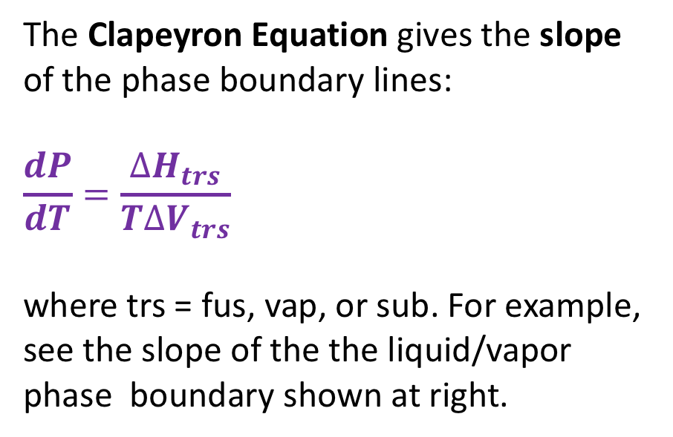
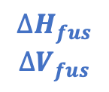

The Clapeyron equation
The Clapeyron Equation gives the slope of the phase boundary lines:
$$\frac{dP}{dT}=\frac{∆H_{trs}}{T∆V_{trs}}$$
where trs = fus, vap, or sub. For example, see the slope of the the liquid/vapor phase boundary shown at right.
$$∆H_{fus}$$
$$∆V_{fus}$$
$$∆H_{vap}$$
$$∆V_{vap}$$
$$∆H_{vap}$$
$$∆V_{vap}$$
$$∆H_{sub}$$
$$∆V_{sub}$$
We’ll derive this equation later. For now we’ll just use it to obtain expressions for the phase boundary lines themselves – by integrating the slope.

Slide 3
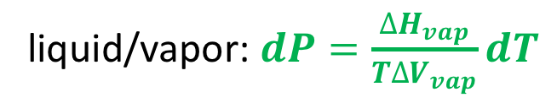
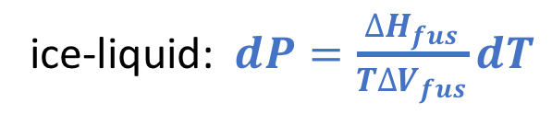
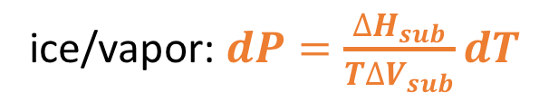
Integrating the Clapeyron Equation
It makes sense to start integration at the triple point because we know $T_{3}$ and $P_{3}$ very accurately
ice-liquid: $dP=\frac{∆H_{fus}}{T∆V_{fus}}dT$
P
liquid/vapor: $dP=\frac{∆H_{vap}}{T∆V_{vap}}dT$
T
ice/vapor: $dP=\frac{∆H_{sub}}{T∆V_{sub}}dT$

Slide 4
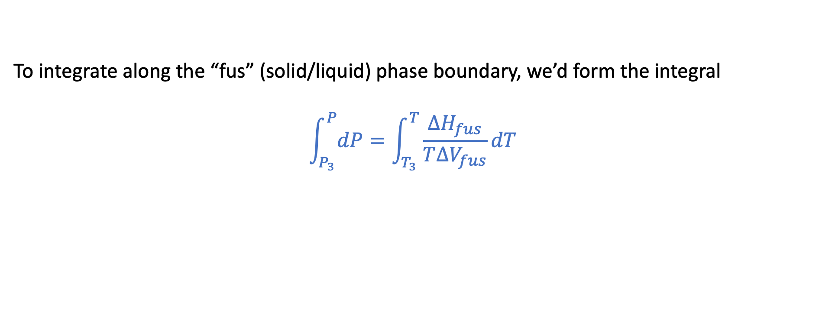
For example, along the solid/liquid phase boundary
P
T
To integrate along the “fus” (solid/liquid) phase boundary, we’d form the integral
$$\int_{P_{3}}^{P}{dP}=\int_{T_{3}}^{T}{\frac{∆H_{fus}}{T∆V_{fus}}dT}$$

Slide 5
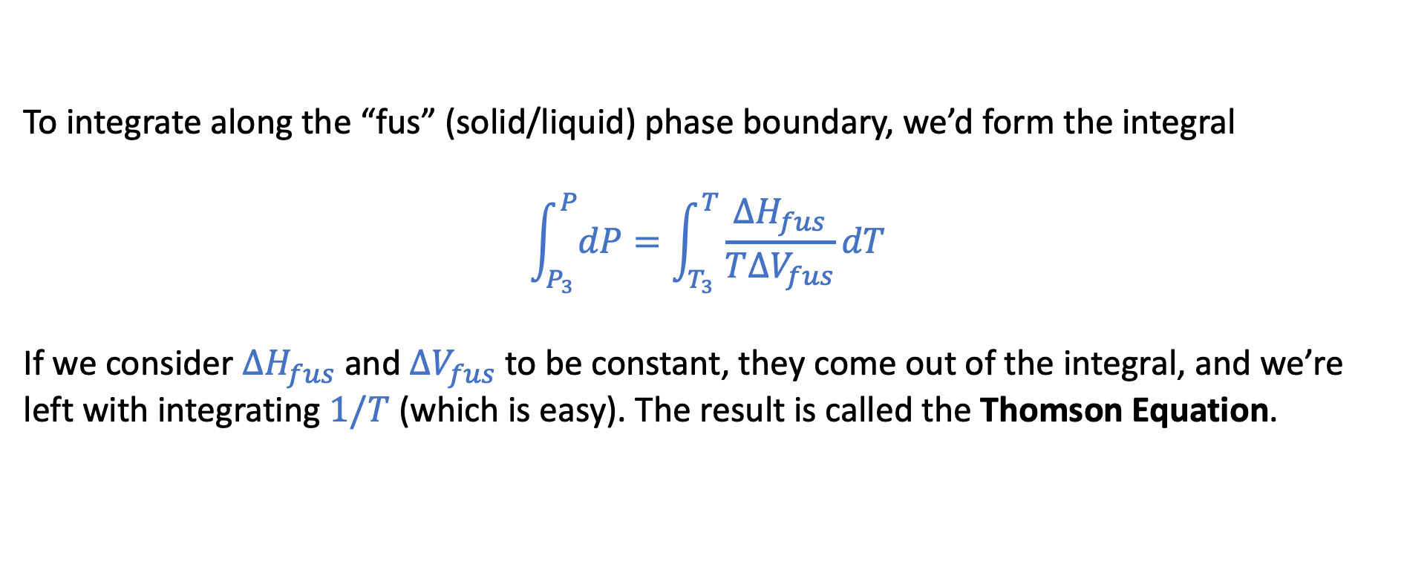
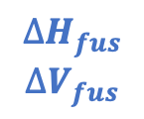
Solid/liquid phase boundary
P
$$∆H_{fus}$$
$$∆V_{fus}$$
T
To integrate along the “fus” (solid/liquid) phase boundary, we’d form the integral
$$\int_{P_{3}}^{P}{dP}=\int_{T_{3}}^{T}{\frac{∆H_{fus}}{T∆V_{fus}}dT}$$
If we consider $∆H_{fus}$ and $∆V_{fus}$ to be constant, they come out of the integral, and we’re left with integrating $1/T$ (which is easy). The result is called the Thomson Equation.

Slide 6


Liquid/vapor phase boundary
P
$$∆H_{vap}$$
$$∆V_{vap}$$
T
For the liquid/vapor boundary, we still start with Clapeyron, $dP=\frac{∆H_{vap}}{T∆V_{vap}}dT$. But there’s a problem: are $∆V_{vap}$ and $∆H_{vap}$ constant along this curve?

Slide 7
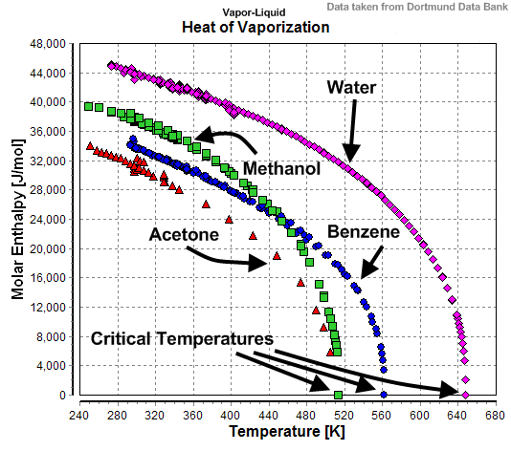
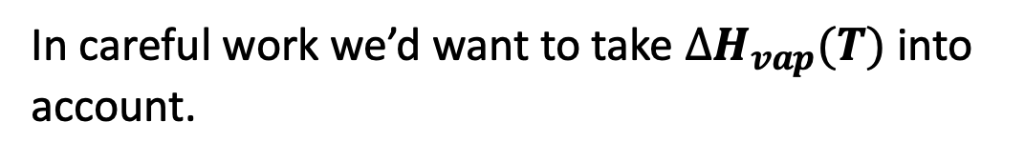
What to do about the temperature-dependence of $∆H_{vap}$?
In careful work we’d want to take $∆H_{vap}(T)$ into account.

Slide 8
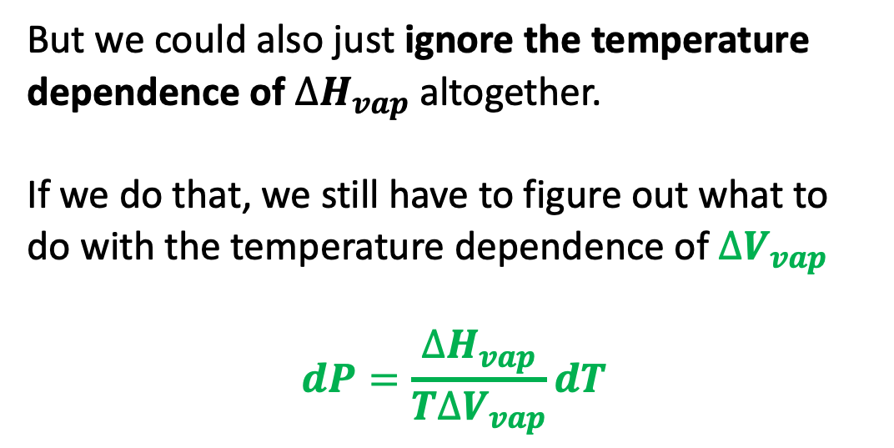
What to do about the temperature-dependence of $∆H_{vap}$?
But we could also just ignore the temperature dependence of $∆H_{vap}$ altogether.
If we do that, we still have to figure out what to do with the temperature dependence of $∆V_{vap}$
$$dP=\frac{∆H_{vap}}{T∆V_{vap}}dT$$

Slide 9
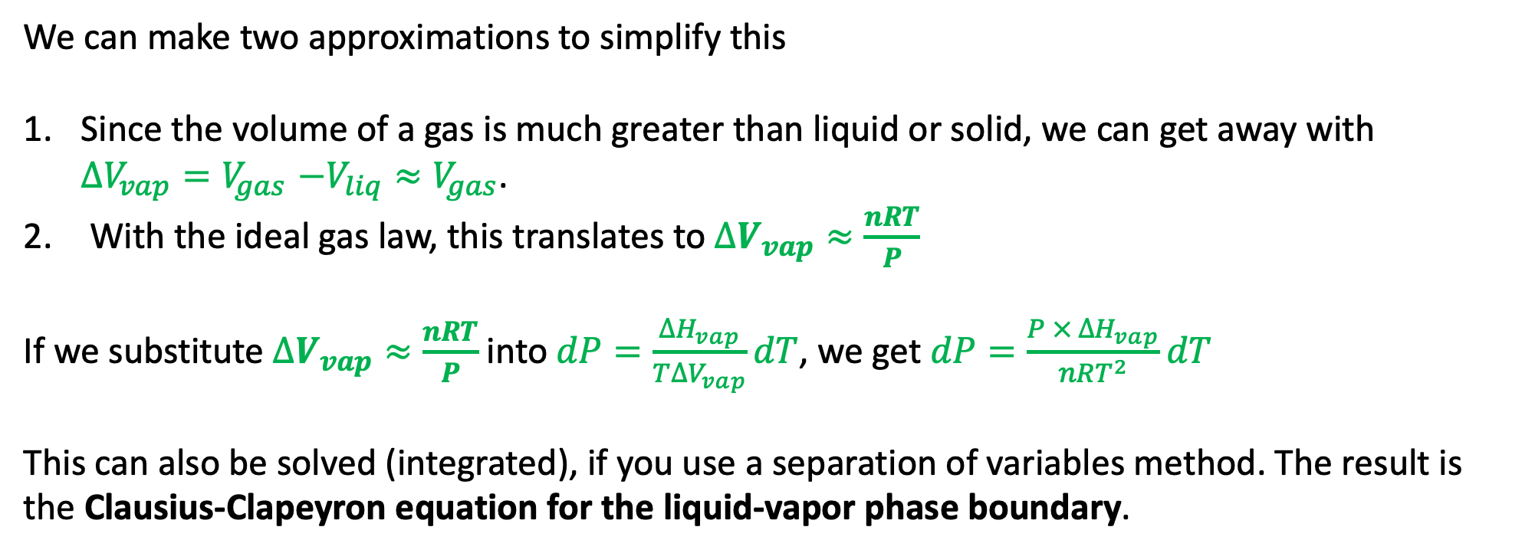
What to do about $∆V_{vap}$ along a liquid-vapor phase boundary …
We can make two approximations to simplify this
Since the volume of a gas is much greater than liquid or solid, we can get away with $∆V_{vap}{=V}_{gas}−V_{liq}≈V_{gas}$.
With the ideal gas law, this translates to $∆V_{vap}≈\frac{nRT}{P}$
If we substitute $∆V_{vap}≈\frac{nRT}{P}$ into $dP=\frac{∆H_{vap}}{T∆V_{vap}}dT$, we get $dP=\frac{P × ∆H_{vap}}{nRT^{2}}dT$
This can also be solved (integrated), if you use a separation of variables method. The result is
the Clausius-Clapeyron equation for the liquid-vapor phase boundary.

Slide 10


The solid/vapor phase boundary
P
For the solid/vapor boundary, all the same considerations apply as to liquid/vapor.
$$∆H_{sub}$$
$$∆V_{sub}$$
T
$$dP=\frac{P × ∆H_{sub}}{nRT^{2}}dT$$

Slide 11
Blackboard work …
$$P=…$$
P
$$P=…$$
T
$$P=…$$

Slide 12

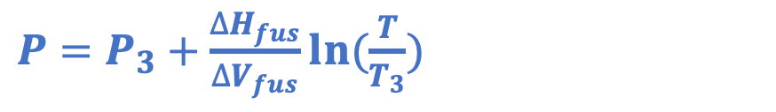
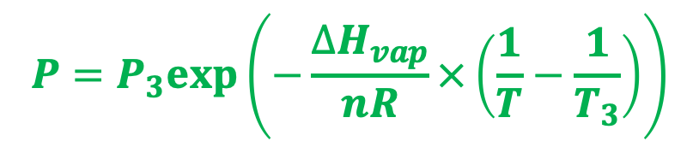
Thomson and Clausius-Clapeyron
$P=P_{3}+\frac{∆H_{fus}}{∆V_{fus}}ln⁡(\frac{T}{T_{3}})$
P
$$P=P_{3}exp⁡\left(−\frac{∆H_{vap}}{nR}×\left(\frac{1}{T}−\frac{1}{T_{3}}\right)\right)$$
T
$P=P_{3}exp⁡\left(−\frac{∆H_{sub}}{nR}×\left(\frac{1}{T}−\frac{1}{T_{3}}\right)\right)$

Slide 13
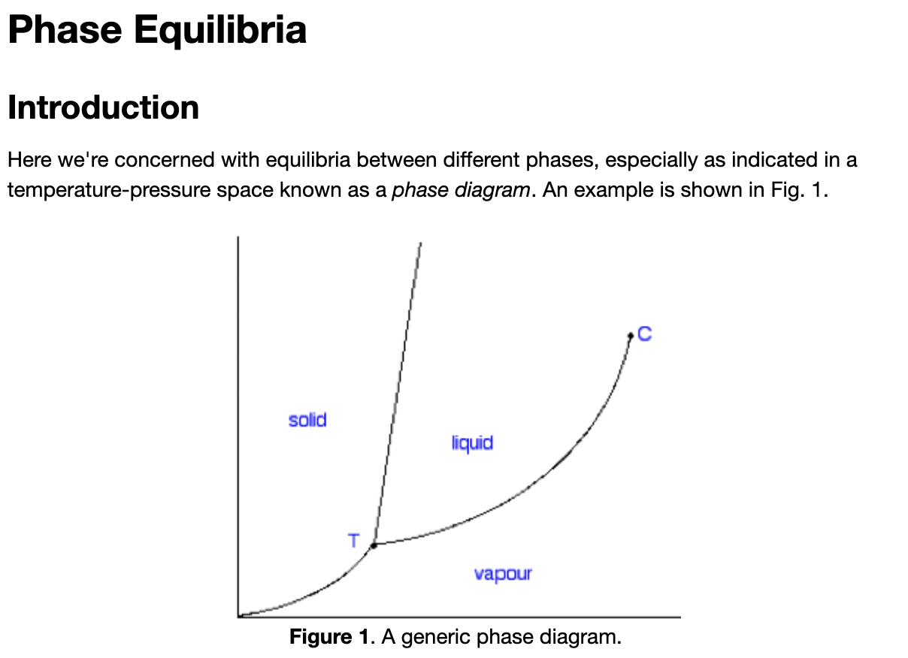
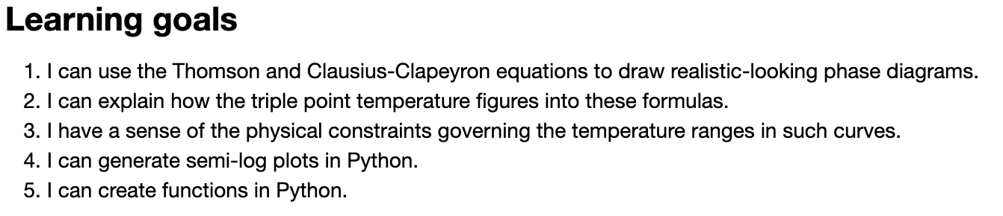
Let’s get started on these ideas in Python …

